Slide 1
Transition of Prothrombinex-VF to Beriplex
In Mid 2024, Prothrombinex-VF will no longer be available. The replacement product called Beriplex will be available for sites via the National Blood Authority.
This resource has been developed to provide clinicians with relevant information on Prothrominex VF transition to Beriplex, and interim Beriplex dosing guidance.
Developed by: Medicines and Technology Unit, Patient Safety and Clinical Quality Division. Updated: 31 July 2024 Version 3

Slide 2
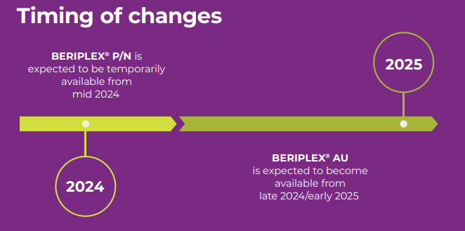
Transition information - timeline
Inventory of Prothrombinex-VF is expected to be exhausted nationally late July 2024 and the transition from Prothrombinex-VF to Beriplex will happen in two stages:
Beriplex P/N will be an interim product available from mid 2024, followed by
Beriplex AU available from late 2024/early 2025
Please note: Beriplex P/N is an overseas product that will be available until the Australian product Beriplex AU becomes available.
Beriplex P/N and Beriplex AU have identical compositions.

Slide 3
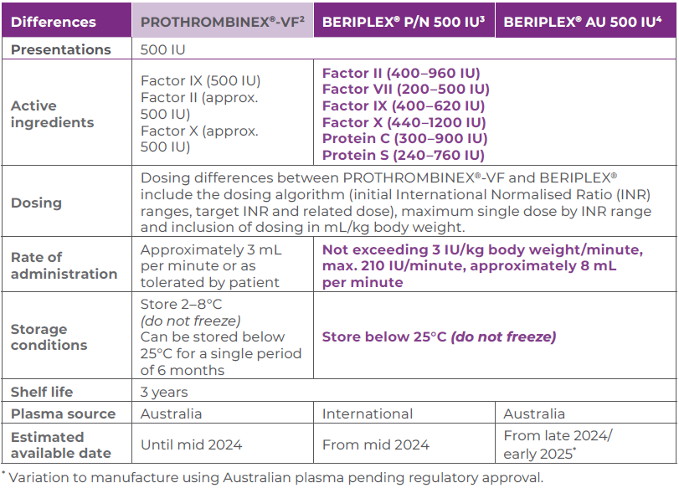
Differences between the products
*
*

Slide 4
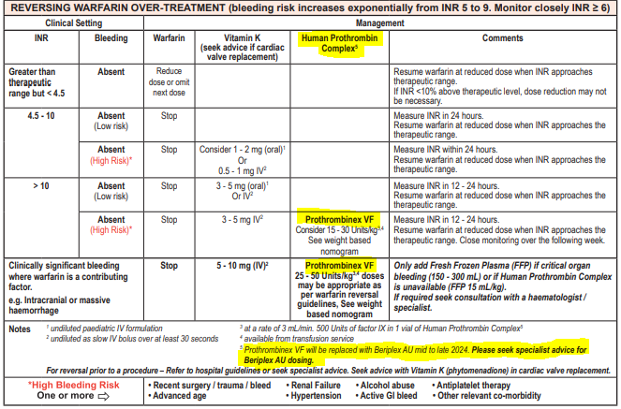
WA Anticoagulation Chart
The WA Anticoagulation Medication Chart has been updated.
The changes to the WA Anticoagulation Medication Chart are highlighted below:
Doses relate only to Prothrombinex VF
Seek specialist advice for Beriplex AU dosing
The WA Anticoagulation Medication Chart will be updated with dosing and indications for Beriplex once these are confirmed.

Slide 5
Beriplex Dosing and Administration Guidance 3 July 2024
This interim guidance has been provided to support the use of Beriplex where local guidelines have not yet been updated. Developed in consultation with the Anticoagulation Steering Group.
Dosing
Beriplex is indicated when there is clinically significant bleeding where warfarin is a contributing factor (e.g. intracranial or massive haemorrhage). Dosing is as per table below.
Dose is based on body weight up to but not exceeding 100 kg.
Repeat INR 30 minutes after administration of Beriplex
Pre-treatment INR | 2.0 - 3.9 | 4.0 – 6.0 | > 6.0
Approximate dose International Units/kg body weight | 25 International Units/kg | 35 International Units/kg | 50 International Units/kg
Administration
Reconstitute 500 International Units with 20 mL Water for Injection using Mix2vial in box.
Administer by slow intravenous injection
at a rate not exceeding 3 International Units/kg body weight/minute
up to a maximum of 210 International Units/minute (approximately 8 mL/minute)

Slide 6
Reversing warfarin over treatment
Clinical Setting |  | Management
INR | Bleeding | Warfarin | Vitamin K |  | Beriplex
Greater than therapeutic range but < 4.5 | Absent | Reduce dose or omit next dose
4.5 -10 | Absent (low risk) | Stop
 | Absent (high risk) | Stop | Consider 1 – 2 mg (oral) or 0.5 – 1 mg (IV)
>10 | Absent (low risk) | Stop | 3 – 5 mg oral or IV
 | Absent (high risk) | Stop | 3 – 5 mg IV |  | Consider 15 – 30 International Units/kg Weight capped at 100kg
Clinically significant bleeding where warfarin is a contributing factor e.g. intracranial or massive haemorrhage |  | Stop | 5-10 mg IV |  | 25 – 50 International Units/kg according to INR#. Weight capped at 100kg
High bleeding risk – One or more of the following |  | Recent surgery/ trauma/ bleed Antiplatelet therapy Active GI bleed |  | Renal Failure Advanced age Other relevant co-morbidity |  | Alcohol abuse Hypertension Thrombocytopenia
The above table was developed with the expert advice from the
WA Anticoagulation Steering Group

Slide 7
Key points
Prothrombinex-VF is being replaced in mid 2024 by Beriplex.
These products are NOT the same (not bioequivalent).
The current Anticoagulation Medication Chart has been amended to :
emphasise the current dosing in the treatment for warfarin overdose table relates only to Prothrombinex-VF.
doses and indication for using Beriplex differ to Prothrombinex-VF, therefore seek specialist advice on using Beriplex.
The WA Anticoagulation Medication Chart will be updated with dosing and indications for Beriplex once supplies have been established and the transition completed.

